Slide 1
Ischemic Heart Diseases
Is a group of closely related syndromes resulting from Imbalance between cardiac blood supply and myocardial demand (myocardial ischemia )

Slide 2
There are 4 clinical syndromes:
1-Angina pectoris.
2- Acute myocardial infarction.
3- Chronic IHD.
4- Sudden cardiac death.

Slide 3
Pathogenesis
Inadequate coronary perfusion occurs from preexisting atherosclerotic lesion and superimposed thrombosis or vasospasm.
A lesion obstructing 70-75% of the vessel lumen causes symptomatic ischemia only on in the setting of increased demands.
While 90% occlusion lead to inadequate coronary blood flow.

Slide 4
If obstruction occurs at a slow rate it may be able to stimulate collaterals and then protect against MI even in complete obstruction.
Three major coronary arteries may be affected. LAD, LCX and RCA.

Slide 5
Role of acute plaque changes:
Unstable angina, acute MI, and SCD occur due to acute changes within the plaque which is due to
1-Rupture, fissuring or ulceration exposing highly thrombogenic plaque constituents.
2-Hemorrhage in to the core of the plaque.

Slide 6
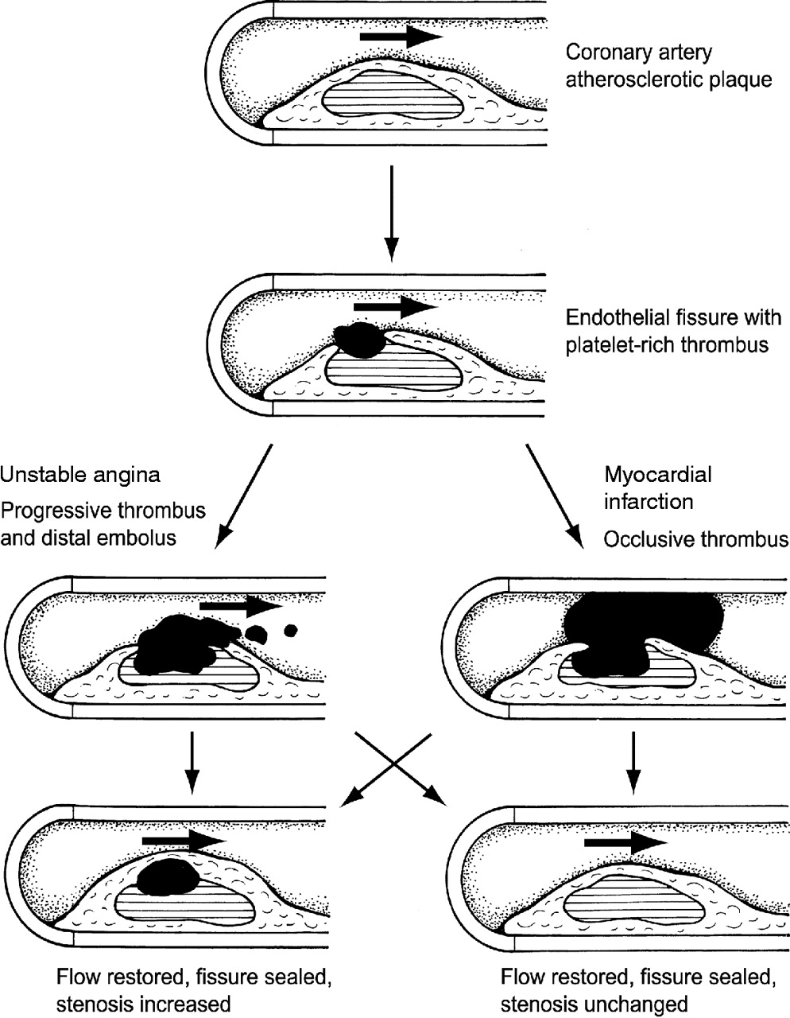
Processes involved in reduction of blood flow during an acute coronary event.
Sheppard L , Channer K Contin Educ Anaesth Crit Care Pain 2004;4:175-180
Continuing Education in Anaesthesia, Critical Care & Pain | Volume 4 Number 6 2004 © The Board of Management and Trustees of the British Journal of Anaesthesia 2004
Notes:
Processes involved in reduction of blood flow during an acute coronary event.

Slide 7
Role of vasoconstriction
Vasoconstriction directly compromises lumen diameter, adrenergic stimulation cause vasospasm

Slide 8
Angina pectoris
Is intermittent chest pain caused by transient reversible myocardial ischemia. It is of 3 types.
1- Typical or stable angina: Episodic chest pain associated with exertion.
2-Prinzmetal angina (Variant angina( occurring at rest due to coronary artery spasm.
3- Unstable angina: Is characterized by increasing frequency of pain with progressively less exertion.

Slide 9
Myocardial infarction
Is a necrosis of heart muscle resulting from ischemia. Most MI are caused by coronary artery thrombosis.

Slide 10
Morphology:
LDA)40-50(%anterior left ventricle, anterior septum, and apex.
RCA )30-4%): Posterior left ventricle, posterior septum, right ventricle.
LCX: Lateral left ventricle.

Slide 11
Grossly: Before 12 hours not apparent. 12-24 h, infracted area appears red blue discoloration due to trapped blood. After that the area becomes sharply defined yellow area. By 10-14 days the infracted area becomes rimmed by hyperemic granulation tissue. After weeks the infracted area replaced by fibrous scar.
Microscopically typical features of coagulative necrosis.

Slide 12
Complications:
1-Arrythmias.
2-Myocardial rupture: 1-5% of MI.
3- Contractile dysfunction and left-sided heart failure.
4- Pericarditis.
5- Aneurysm

Slide 13
Chronic ischemic heart disease:
Is progressive heart failure due to ischemic injury either from prior infarction or chronic low grade ischemia

Slide 14
Sudden Cardiac death:
Result from fatal arrhythmias most commonly in patients with severe coronary artery disease.

